Slide 1
Decathlon
Sales Data Presentation by Senior Data Analyst

Slide 2
Contents
Key Questions
Data Overview
Cross Regional Metrics
Temporal Factors
Relationships
Forecast

Slide 3
Key Questions
What new metrics can be deduced?
Does more product types and working hours affect bottom line?
Which regions are most affected by Christmas?
How much is the expected demand for Christmas Products for next year?

Slide 4
Data Overview
Objective: Data Analysis
Business Unit: Decathlon International
Domain: Retail Sales
Location: International
Time: 2009 to 2010
Dimensions: 100k by 5
Types: Text and Numeric

Slide 5
Table for Analysis
 | Country | Working_Days | Quantity_Sold | Quantity_Returned | Returnrate | Profit | No.Customers | UniqueProducts | NonHoliday_revenue | Holiday_revenue | Holidayrevenueshare
1 | Australia | 88 | 104398 | 692 | 1 | 8111.07 | 15 | 1913 | 120303.08 | 46825.99 | 38.92
2 | Austria | 42 | 11578 | 272 | 2 | 4184.32 | 13 | 938 | 13755.46 | 9422.14 | 68.50
3 | Bahrain | 12 | 1339 | 64 | 5 | 439.49 | 3 | 126 | 2338.05 | 523.5 | 22.39
4 | Belgium | 147 | 35312 | 180 | 1 | 14766.88 | 29 | 3123 | 41026.66 | 22547.83 | 54.96
5 | Canada | 8 | 3657 | 0 | 0 | 1058.09 | 5 | 228 | 3666.38 | 1216.66 | 33.18
6 | Channel Islands | 61 | 21482 | 1009 | 5 | 9056.8 | 14 | 1664 | 29963.56 | 11490.05 | 38.35
Index:
Working_Days: Number of missing days from data
Quantity_Returned: sum of all negative Quantities
Returnrate: Ratio of goods sold and returned
Profit: Price x Quantity less Return
No.Customers: Number of unique customerID
UniqueProducts: Number of unique Stockcode
NonHoliday_revenue: January to October
Holiday_revenue: October to December
Holidayrevenueshare: Ratio of Holiday_revenue /NonHoliday_revenue

Slide 6
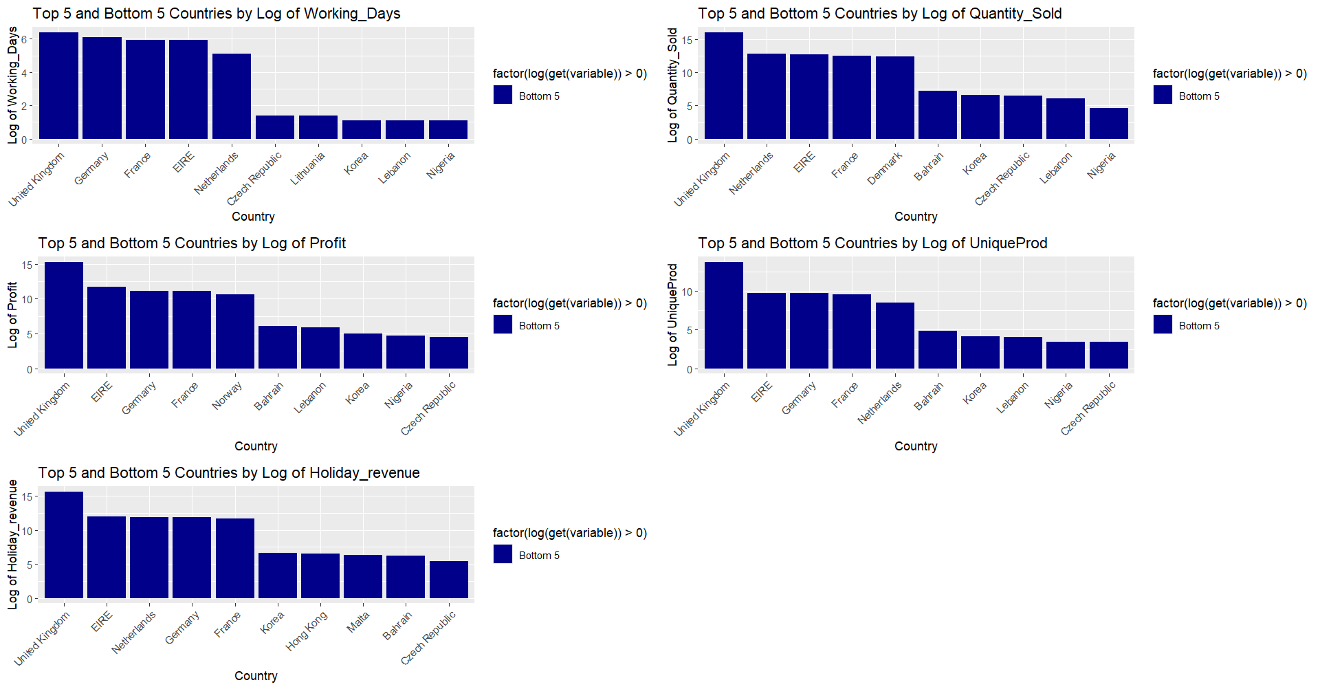
Cross Regional Metrics

Slide 7
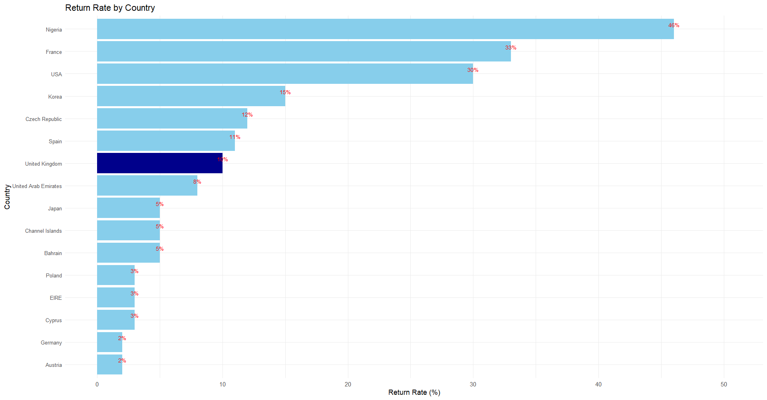

Slide 8
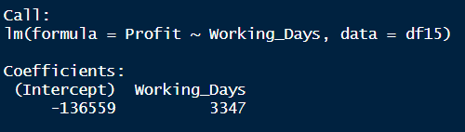
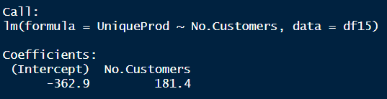
Relationship between Working days and Profit:
This indicates that, on average, for each additional unit increase in Working days, the Profit is expected to increase by 3347 units.
Relationship between Number of Products and Number of Customers
This indicates that, on average, for each additional unit increase in the number of customers, the demand/number of unique products is expected to increase by 181.4 units.

Slide 9
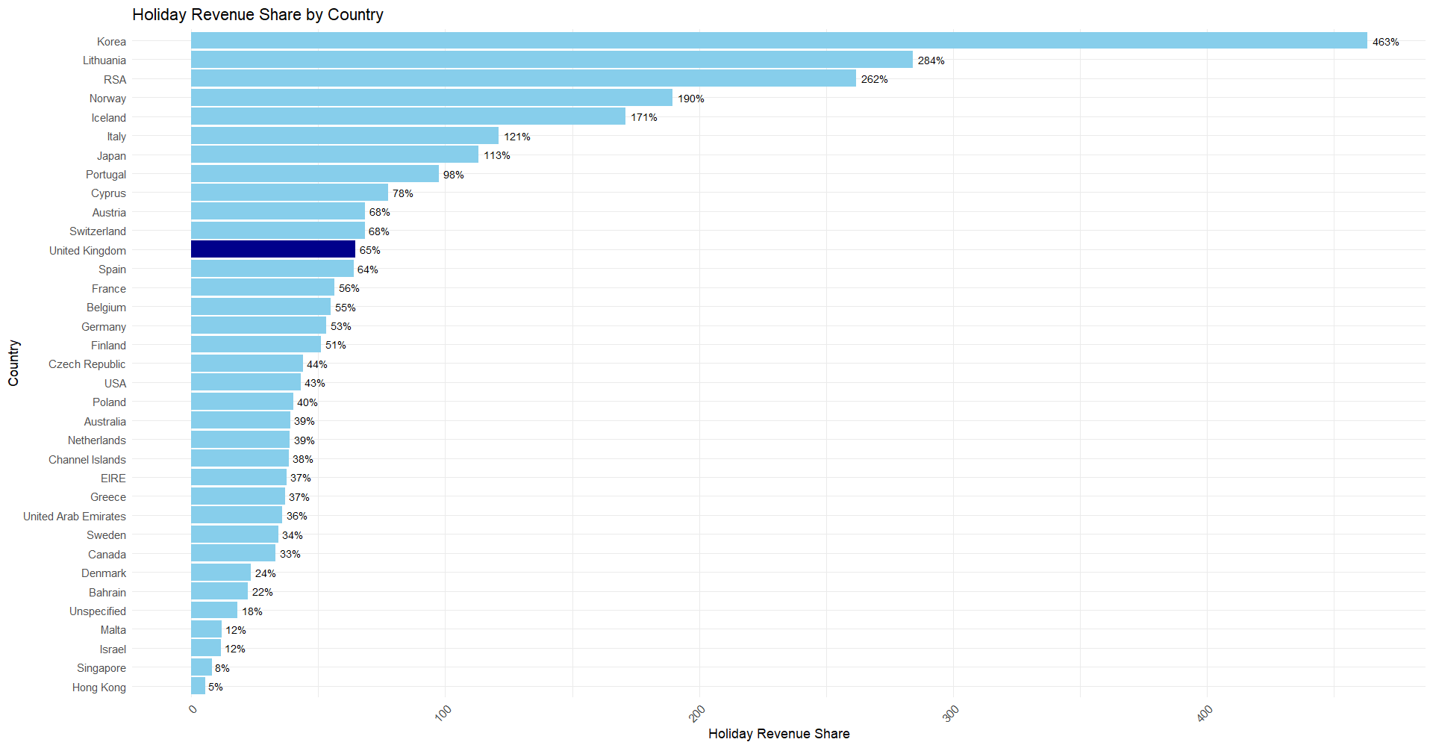
UK outlets gain 65% of their annual revenue during the holiday season Oct to Dec

Slide 10
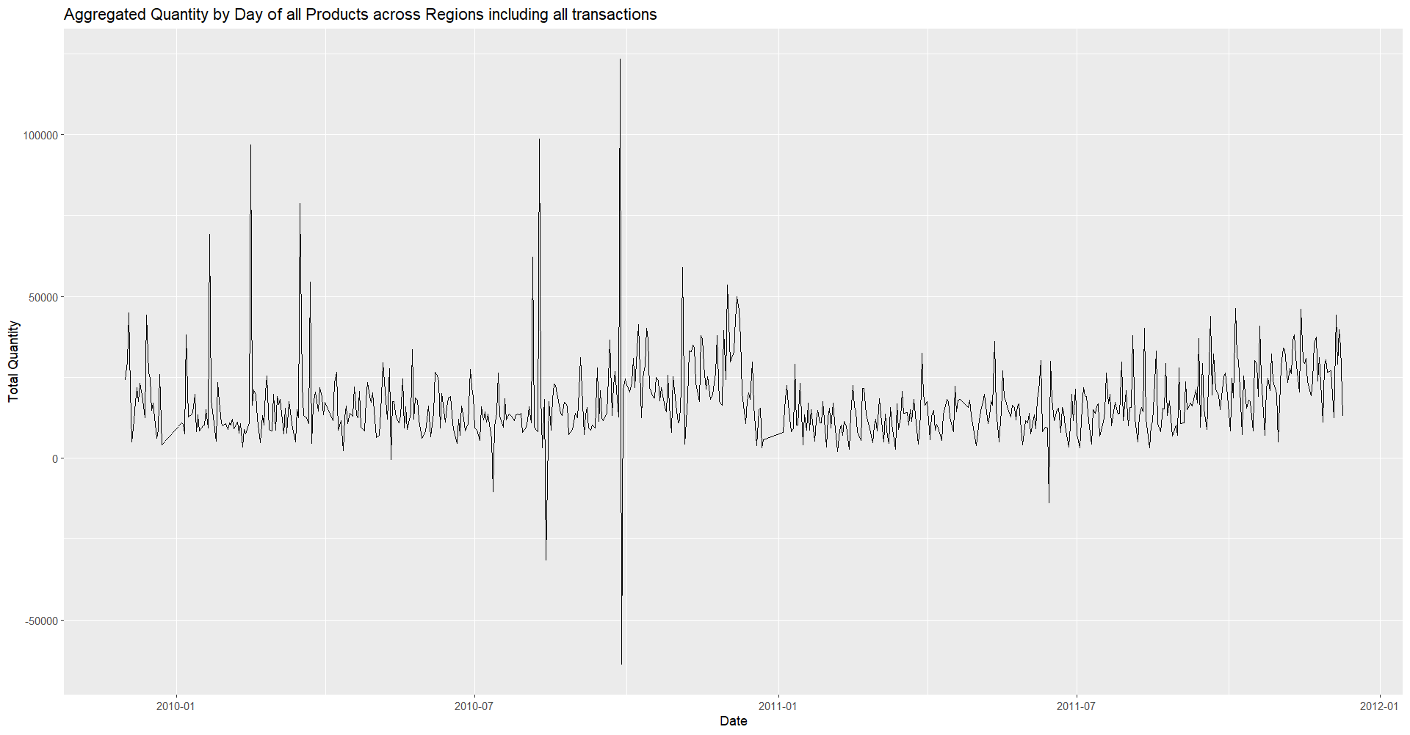
*Simple time series plot of quantity sold with no pre processing

Slide 11
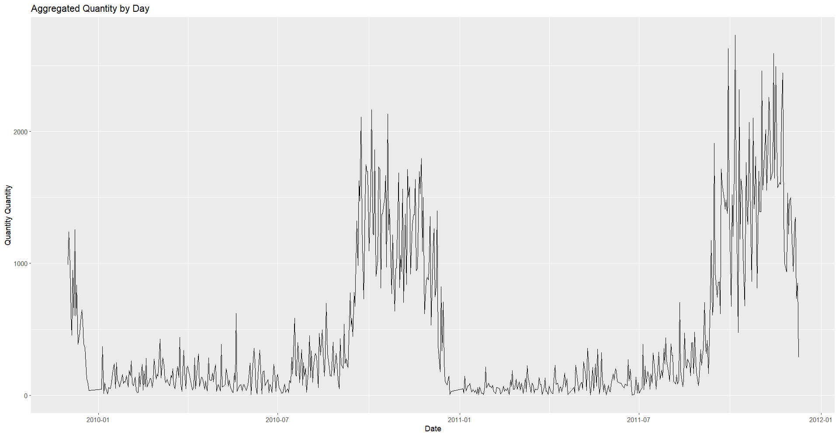
Time series of Quantity after basic cleaning: Exclude NA | Exclude Returns | Include only UK | Include only Christmas items |Exclude customers whose total expenses outside 1.5*IQR | Aggregate quantity by day

Slide 12
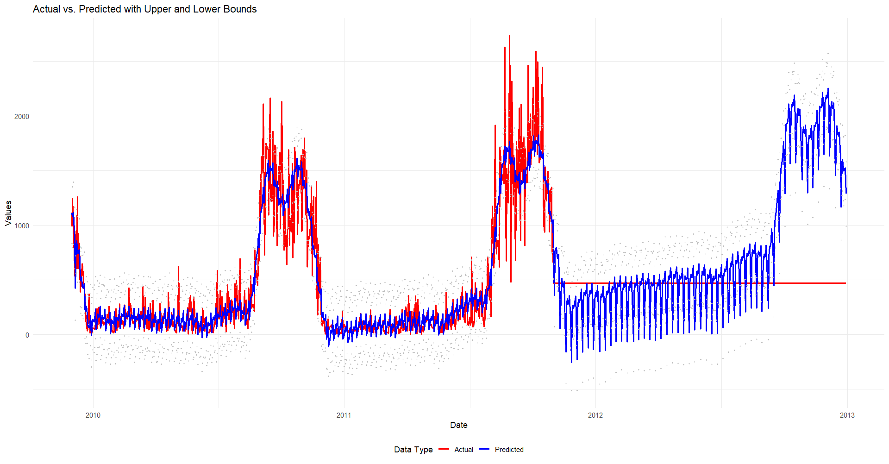
Forecast of Christmas Items Quantity Demanded in UK during Holiday Season using Prophet package.

Slide 13
Further Analysis Requirements
Require Additional Holiday seasons to validate forecast
Require Product descriptions and Categories for greater granularity in “Christmas Item Selection” instead of text mining on Lights|Tree|Christmas|Ornament|Decoration
More clustered regions for simpler analysis eg. All EU or all SEA instead of scattered regions.
More variables for each outlet eg. number of staff, working hours, number of close competitors
Should add GDP percapita for sensible comparison of profitability.
Additional time and validation to beautify graphics and formulate crisp points.

